Slide 1
Taking Care of Mental Health of Children during COVID - 19
State Institute of Health & Family Welfare
Rajasthan

Slide 2
Need
The Outbreak of COVID -19 and its consequences can make children anxious and stressed.
Take care of their Mental Health with these simple strategies.
Ref: National Institute of Mental Health and Neuro-Science/MoHFW

Slide 4
Provide Assurance
Reassure your children
Listen to their concerns & try answering their queries related to the outbreak.
Spend quality time & attention
Reading them stories to put them to sleep will make them feel loved.
Ref: National Institute of Mental Health and Neuro-Science/MoHFW

Slide 5
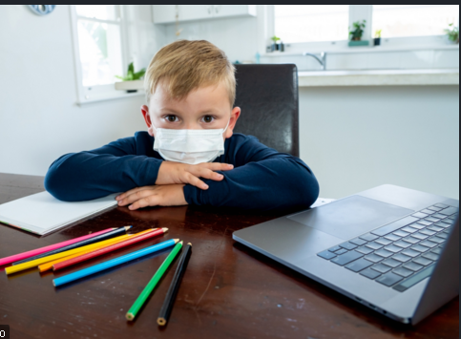
Keep Them in Contact with Their Friends
Encourage them to talk to their Friends, cousins and loved ones by calling them or video calls.
Plan any fun activity with their friends, which they can do together by staying connected virtually.
Ref: National Institute of Mental Health and Neuro-Science/MoHFW

Slide 6
Manage your Child’s Anxiety
It is normal for your child to become anxious at this time.
Avoid being judgmental when they express their feelings.
Do not avoid their questions related to COVID
Make them understand that things will be better if we take proper care. Your main message should be: "You are safe.
Ref: National Institute of Mental Health and Neuro-Science/MoHFW

Slide 7
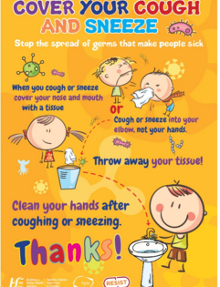
Give them Clear Information
Give them correct information as to what is happening around the world.
Give them proper facts , do not remain confused
Explain through pictures and drawings.
Ref: National Institute of Mental Health and Neuro-Science/MoHFW

Slide 8
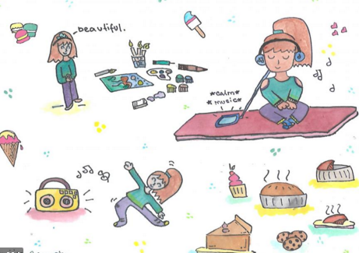
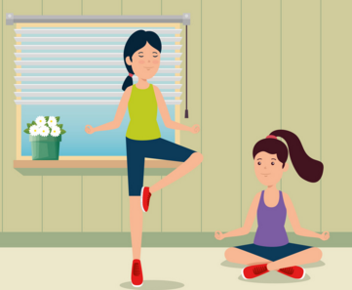
Engage Them in Indoor Activities
Involve in indoor games to cut down the boredom- Puzzle, craft etc.
Encourage them to pick up a hobby.
Involve in some exercise, yoga, dancing
Involve them in doing simple house hold activities to keep them engaged
Ref: National Institute of Mental Health and Neuro-Science/MoHFW

Slide 9
Make a Routine of Learning at Home
At this time school is closed, ensure that they have a regular habit of studying by giving them small assignments related to their lessons.
Check the assignments to understand their progress
Ref: National Institute of Mental Health and Neuro-Science/MoHFW

Slide 10
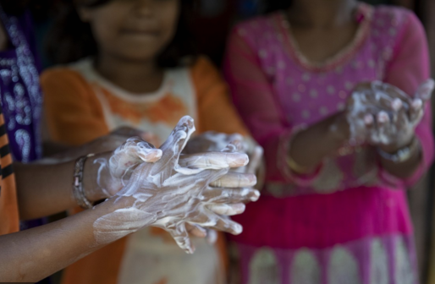
Care of Children’s Health
Ensure they practice hand washing and cover their mouth and nose with bent elbow during cough & sneeze.
Ensure that the children eat healthy food and get good sleep and rest.
If any symptoms of COVID-19 reach out to the doctor
Ref: National Institute of Mental Health and Neuro-Science/MoHFW

Slide 11
Thank You

